Slide 1
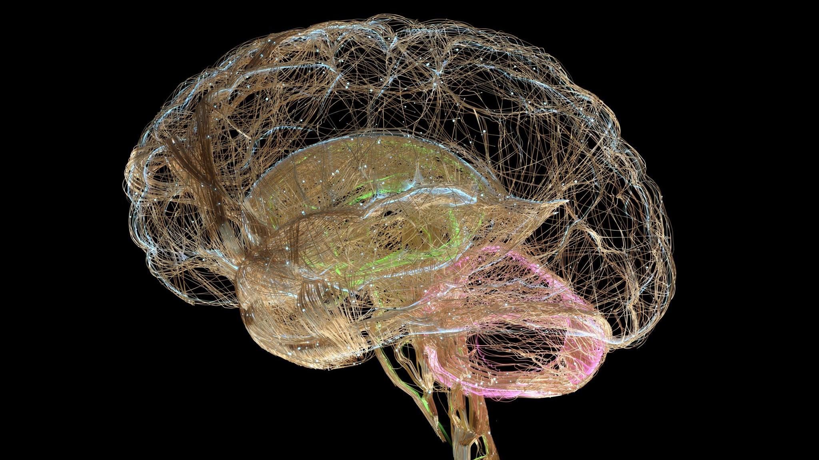
Analysis of mouse hippocampal neuron morphology across ApoE4 strains
By Evan Paltjon

Slide 2
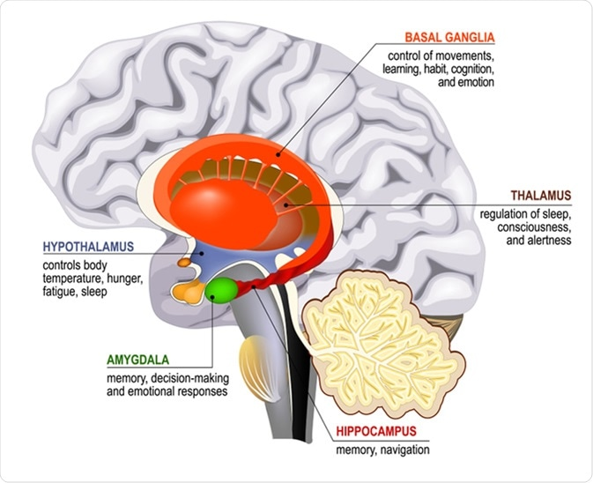
Hippocampus
Memory formation and retrieval
One of the first regions impacted by Alzheimer’s

Slide 3
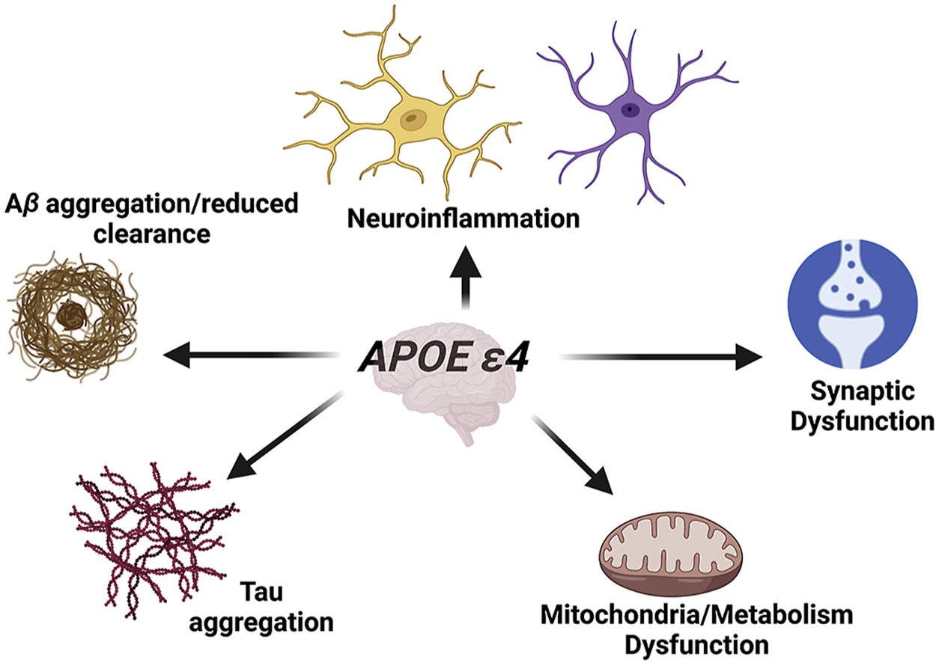
APOE4 increases risk of dementia development
Notes:
Encodes a lipid metabolism protein responsible for lipid and cholesterol transport between tissues and cells
3 different apolipoprotein E gene variants

Slide 4
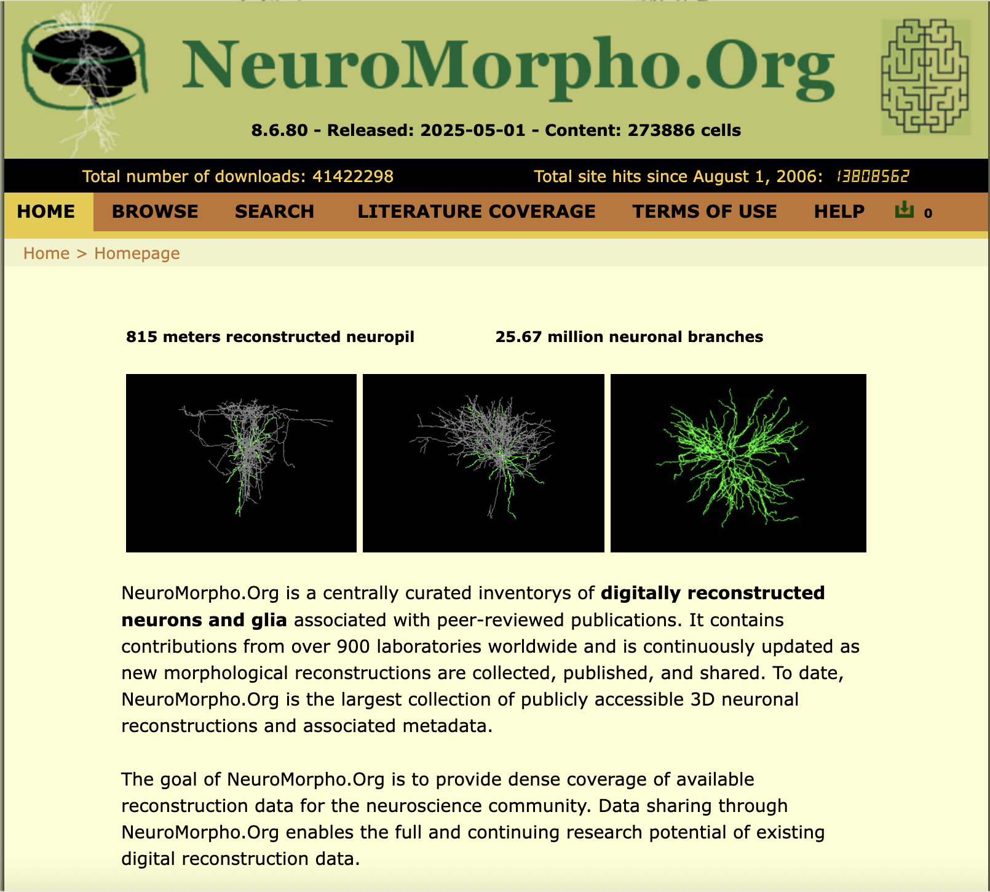
Notes:
# Load necessary libraries
library(httr)
library(jsonlite)
library(dplyr)
library(purrr)
library(ggplot2)
library(ggpubr)
library(scales)
# Function to get neuron data from the API
get_all_neurons <- function(max_pages = 10, page_size = 500) {
base_url <- "http://cng.gmu.edu:8080/api/neuron"
all_neurons <- list()
for (page in 0:(max_pages - 1)) {
tryCatch({
query <- list(size = page_size, page = page)
response <- GET(url = base_url, query = query)
if (status_code(response) != 200) {
message("Stopping: Received status code ", status_code(response), " on page ", page)
break
}
json_data <- content(response, as = "text", encoding = "UTF-8")
data <- fromJSON(json_data, flatten = TRUE)
if (is.null(data$`_embedded`$neuronResources)) {
message("No more data available at page ", page)
break
}
all_neurons[[page + 1]] <- data$`_embedded`$neuronResources
message("Successfully retrieved page ", page + 1)
}, error = function(e) {
message("Error on page ", page, ": ", e$message)
break
})
}
bind_rows(all_neurons) %>% distinct()
}

Slide 5
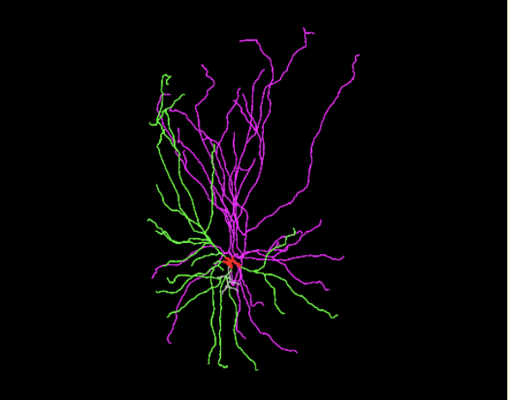
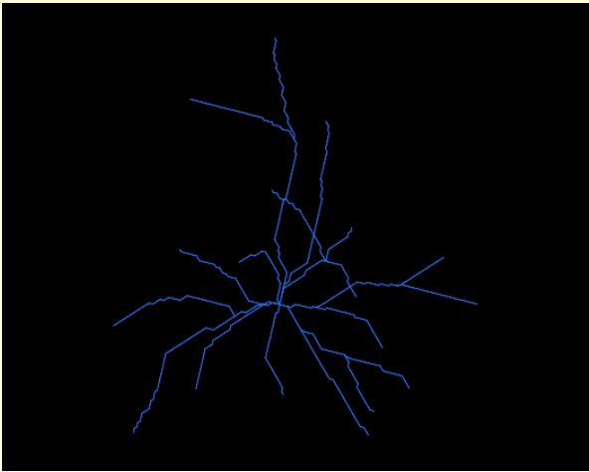
Digitally Reconstructed CNS Cells
Hippocampal Neuron
Hippocampal Astrocyte

Slide 6
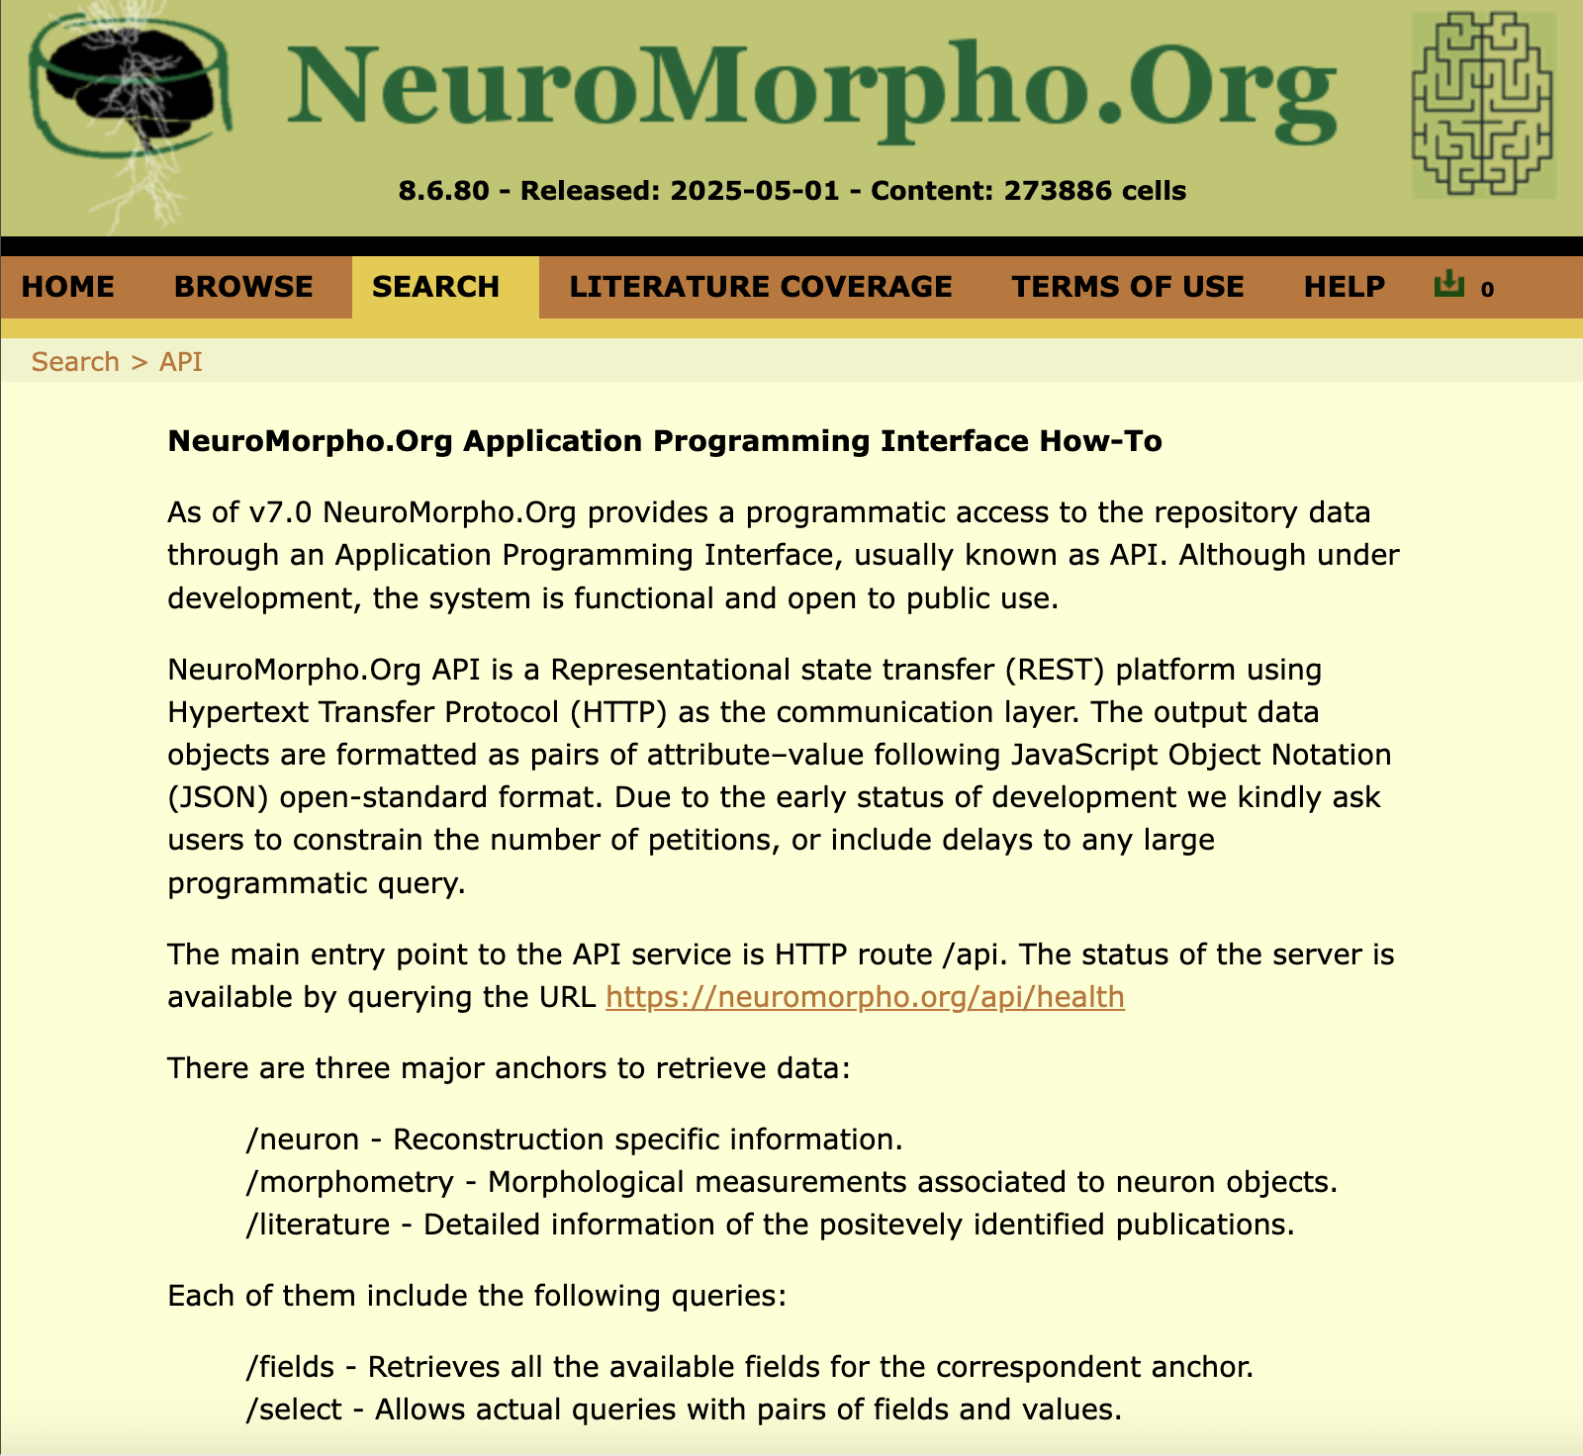
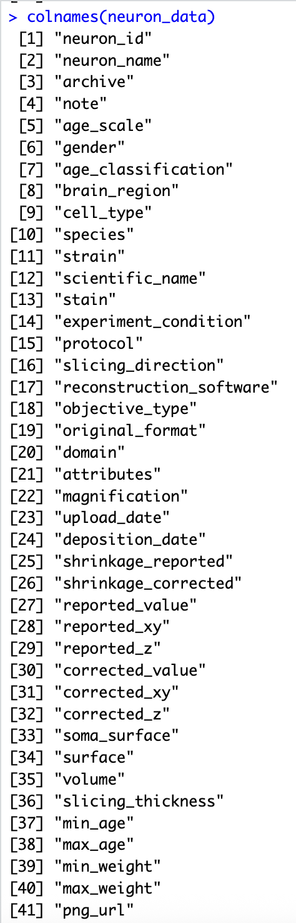

Slide 7
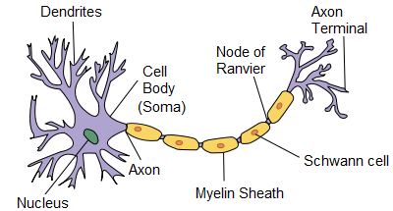
Basic Anatomy of a Neuron

Slide 8
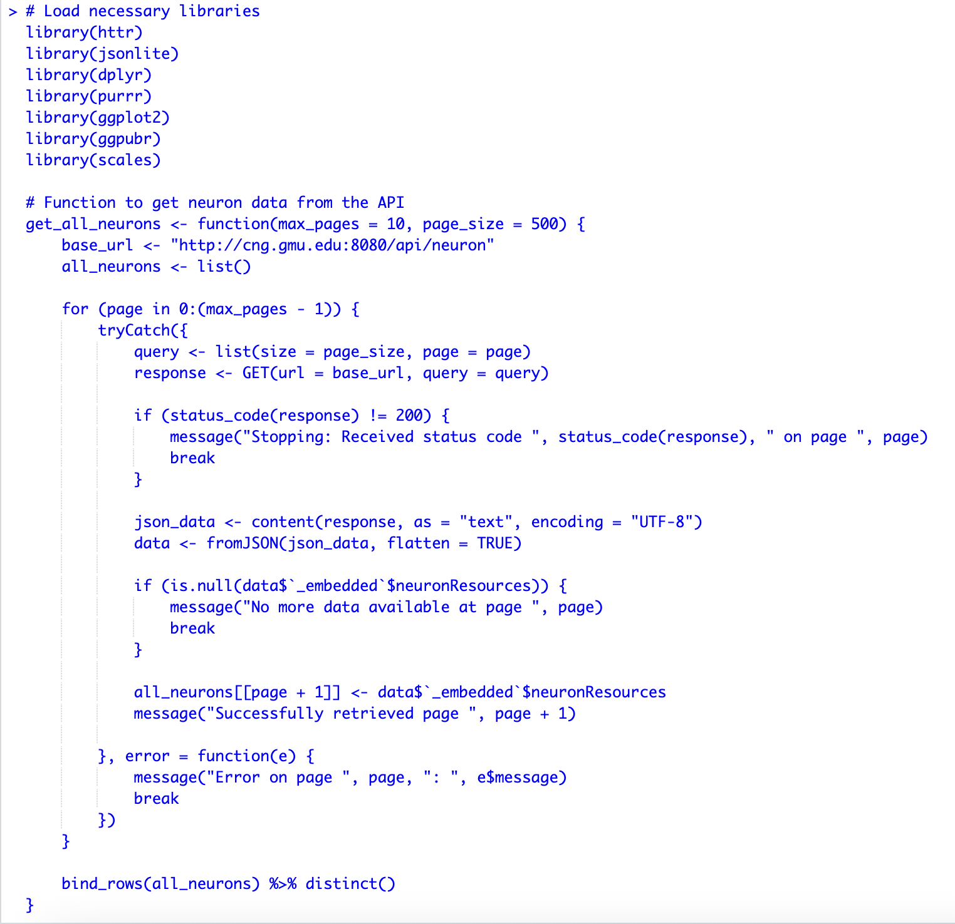
Httr: interacts with web APIs
Jsonlite: converts JSON data to R format
Dplyr: data manipulation
Purrr: data manipulation

Slide 9
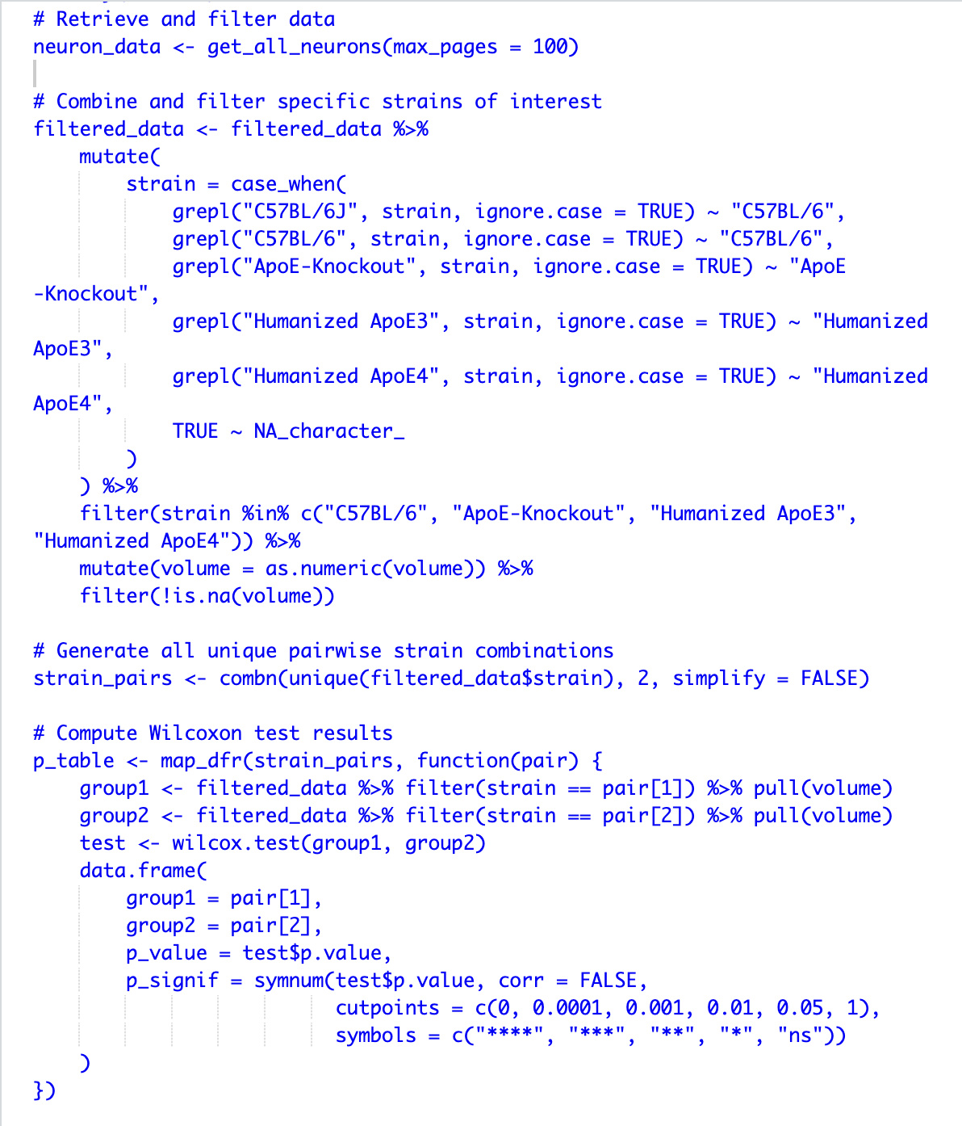

Slide 10
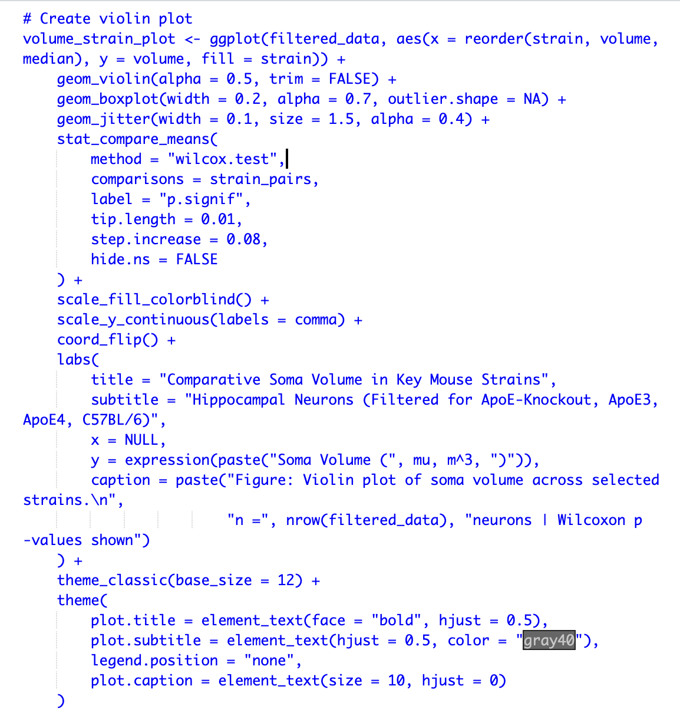

Slide 11
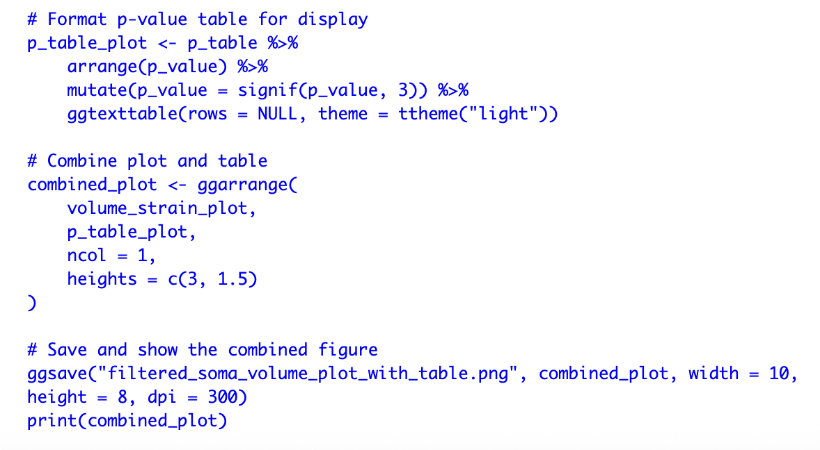

Slide 12
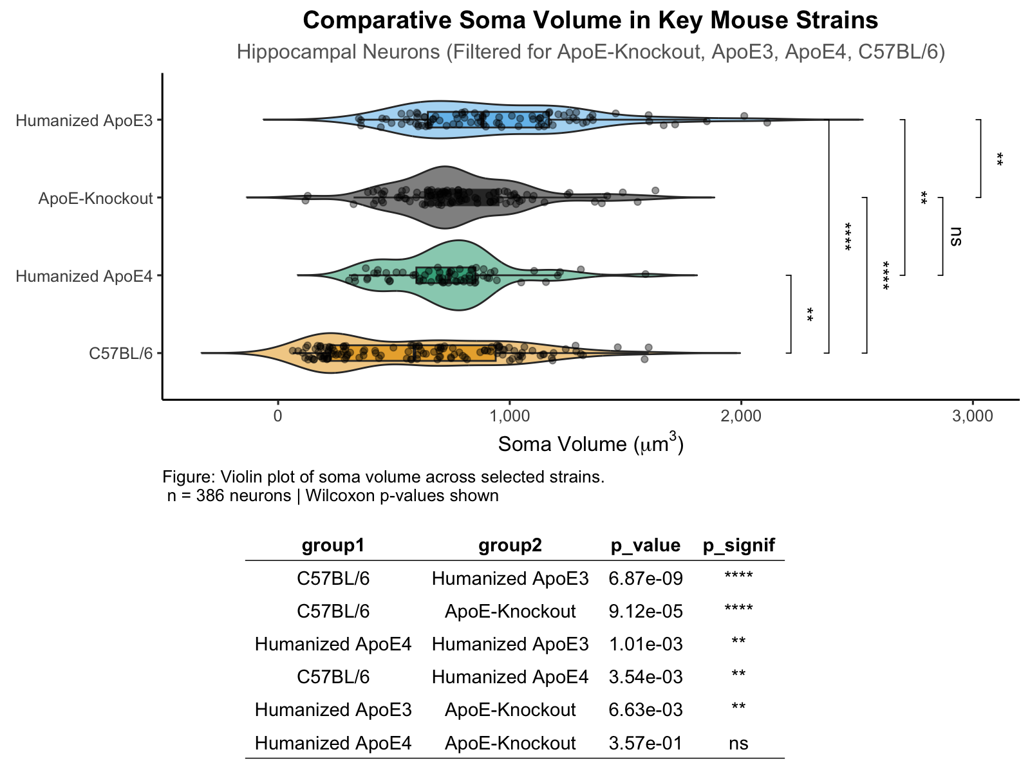
Notes:
library(dplyr)
library(ggplot2)
library(ggpubr)
library(scales)
library(rstatix)
# Combine and filter specific strains of interest
filtered_data <- filtered_data %>%
mutate(
strain = case_when(
grepl("C57BL/6J", strain, ignore.case = TRUE) ~ "C57BL/6",
grepl("C57BL/6", strain, ignore.case = TRUE) ~ "C57BL/6",
grepl("ApoE-Knockout", strain, ignore.case = TRUE) ~ "ApoE-Knockout",
grepl("Humanized ApoE3", strain, ignore.case = TRUE) ~ "Humanized ApoE3",
grepl("Humanized ApoE4", strain, ignore.case = TRUE) ~ "Humanized ApoE4",
TRUE ~ NA_character_
)
) %>%
filter(strain %in% c("C57BL/6", "ApoE-Knockout", "Humanized ApoE3", "Humanized ApoE4")) %>%
mutate(volume = as.numeric(volume)) %>%
filter(!is.na(volume))
# Generate all unique pairwise strain combinations
strain_pairs <- combn(unique(filtered_data$strain), 2, simplify = FALSE)
# Compute Wilcoxon test results
p_table <- map_dfr(strain_pairs, function(pair) {
group1 <- filtered_data %>% filter(strain == pair[1]) %>% pull(volume)
group2 <- filtered_data %>% filter(strain == pair[2]) %>% pull(volume)
test <- wilcox.test(group1, group2)
data.frame(
group1 = pair[1],
group2 = pair[2],
p_value = test$p.value,
p_signif = symnum(test$p.value, corr = FALSE,
cutpoints = c(0, 0.0001, 0.001, 0.01, 0.05, 1),
symbols = c("****", "***", "**", "*", "ns"))
)
})
# Save p-value table
write.csv(p_table, "soma_volume_filtered_pvalues.csv", row.names = FALSE)
# Create violin plot
volume_strain_plot <- ggplot(filtered_data, aes(x = reorder(strain, volume, median), y = volume, fill = strain)) +
geom_violin(alpha = 0.5, trim = FALSE) +
geom_boxplot(width = 0.2, alpha = 0.7, outlier.shape = NA) +
geom_jitter(width = 0.1, size = 1.5, alpha = 0.4) +
stat_compare_means(
method = "wilcox.test",
comparisons = strain_pairs,
label = "p.signif",
tip.length = 0.01,
step.increase = 0.08,
hide.ns = FALSE
) +
scale_fill_colorblind() +
scale_y_continuous(labels = comma) +
coord_flip() +
labs(
title = "Comparative Soma Volume in Key Mouse Strains",
subtitle = "Hippocampal Neurons (Filtered for ApoE-Knockout, ApoE3, ApoE4, C57BL/6)",
x = NULL,
y = expression(paste("Soma Volume (", mu, m^3, ")")),
caption = paste("Figure: Violin plot of soma volume across selected strains.\n",
"n =", nrow(filtered_data), "neurons | Wilcoxon p-values shown")
) +
theme_classic(base_size = 12) +
theme(
plot.title = element_text(face = "bold", hjust = 0.5),
plot.subtitle = element_text(hjust = 0.5, color = "gray40"),
legend.position = "none",
plot.caption = element_text(size = 10, hjust = 0)
)
# Format p-value table for display
p_table_plot <- p_table %>%
arrange(p_value) %>%
mutate(p_value = signif(p_value, 3)) %>%
ggtexttable(rows = NULL, theme = ttheme("light"))
# Combine plot and table
combined_plot <- ggarrange(
volume_strain_plot,
p_table_plot,
ncol = 1,
heights = c(3, 1.5)
)
# Save and show the combined figure
ggsave("filtered_soma_volume_plot_with_table.png", combined_plot, width = 10, height = 8, dpi = 300)
print(combined_plot)

Slide 13
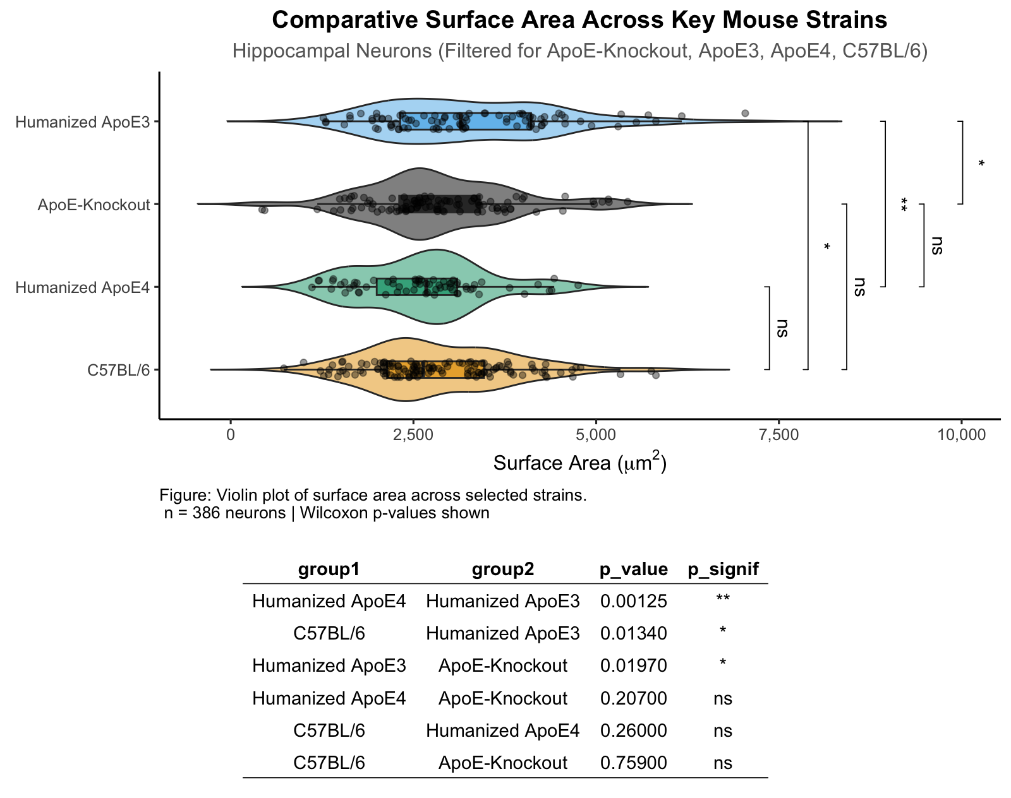
Notes:
library(dplyr)
library(ggplot2)
library(ggpubr)
library(scales)
library(rstatix)
# Combine and filter specific strains of interest
filtered_data <- filtered_data %>%
mutate(
strain = case_when(
grepl("C57BL/6J", strain, ignore.case = TRUE) ~ "C57BL/6",
grepl("C57BL/6", strain, ignore.case = TRUE) ~ "C57BL/6",
grepl("ApoE-Knockout", strain, ignore.case = TRUE) ~ "ApoE-Knockout",
grepl("Humanized ApoE3", strain, ignore.case = TRUE) ~ "Humanized ApoE3",
grepl("Humanized ApoE4", strain, ignore.case = TRUE) ~ "Humanized ApoE4",
TRUE ~ NA_character_
)
) %>%
filter(strain %in% c("C57BL/6", "ApoE-Knockout", "Humanized ApoE3", "Humanized ApoE4")) %>%
mutate(surface = as.numeric(surface)) %>%
filter(!is.na(surface))
# Generate all unique pairwise strain combinations
strain_pairs <- combn(unique(filtered_data$strain), 2, simplify = FALSE)
# Compute Wilcoxon test results
p_table <- map_dfr(strain_pairs, function(pair) {
group1 <- filtered_data %>% filter(strain == pair[1]) %>% pull(surface)
group2 <- filtered_data %>% filter(strain == pair[2]) %>% pull(surface)
test <- wilcox.test(group1, group2)
data.frame(
group1 = pair[1],
group2 = pair[2],
p_value = test$p.value,
p_signif = symnum(test$p.value, corr = FALSE,
cutpoints = c(0, 0.0001, 0.001, 0.01, 0.05, 1),
symbols = c("****", "***", "**", "*", "ns"))
)
})
# Save p-value table
write.csv(p_table, "surface_filtered_pvalues.csv", row.names = FALSE)
# Create violin plot
surface_strain_plot <- ggplot(filtered_data, aes(x = reorder(strain, surface, median), y = surface, fill = strain)) +
geom_violin(alpha = 0.5, trim = FALSE) +
geom_boxplot(width = 0.2, alpha = 0.7, outlier.shape = NA) +
geom_jitter(width = 0.1, size = 1.5, alpha = 0.4) +
stat_compare_means(
method = "wilcox.test",
comparisons = strain_pairs,
label = "p.signif",
tip.length = 0.01,
step.increase = 0.08,
hide.ns = FALSE
) +
scale_fill_colorblind() +
scale_y_continuous(labels = comma) +
coord_flip() +
labs(
title = "Comparative Surface Area Across Key Mouse Strains",
subtitle = "Hippocampal Neurons (Filtered for ApoE-Knockout, ApoE3, ApoE4, C57BL/6)",
x = NULL,
y = expression(paste("Surface Area (", mu, m^2, ")")),
caption = paste("Figure: Violin plot of surface area across selected strains.\n",
"n =", nrow(filtered_data), "neurons | Wilcoxon p-values shown")
) +
theme_classic(base_size = 12) +
theme(
plot.title = element_text(face = "bold", hjust = 0.5),
plot.subtitle = element_text(hjust = 0.5, color = "gray40"),
legend.position = "none",
plot.caption = element_text(size = 10, hjust = 0)
)
# Format p-value table for display
p_table_plot <- p_table %>%
arrange(p_value) %>%
mutate(p_value = signif(p_value, 3)) %>%
ggtexttable(rows = NULL, theme = ttheme("light"))
# Combine plot and table
combined_plot <- ggarrange(
surface_strain_plot,
p_table_plot,
ncol = 1,
heights = c(3, 1.5)
)
# Save and show the combined figure
ggsave("filtered_surface_plot_with_table.png", combined_plot, width = 10, height = 8, dpi = 300)
print(combined_plot)

Slide 14
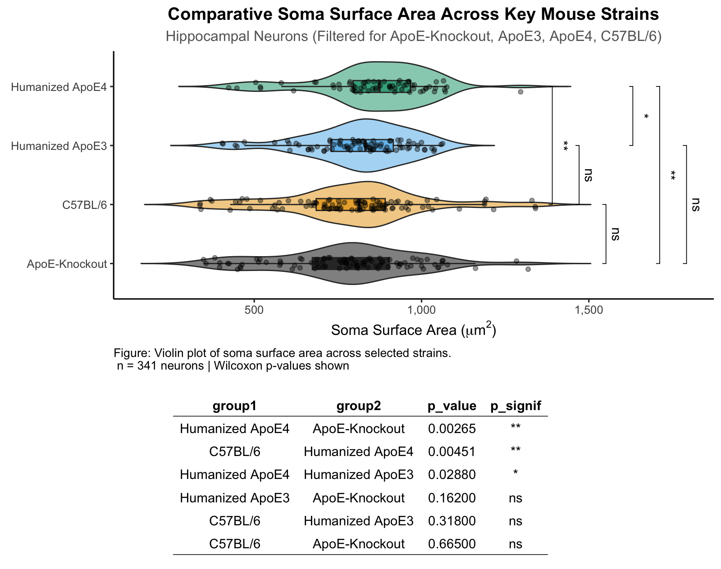
Notes:
library(dplyr)
library(ggplot2)
library(ggpubr)
library(scales)
library(rstatix)
# Combine and filter specific strains of interest
filtered_data <- filtered_data %>%
mutate(
strain = case_when(
grepl("C57BL/6J", strain, ignore.case = TRUE) ~ "C57BL/6",
grepl("C57BL/6", strain, ignore.case = TRUE) ~ "C57BL/6",
grepl("ApoE-Knockout", strain, ignore.case = TRUE) ~ "ApoE-Knockout",
grepl("Humanized ApoE3", strain, ignore.case = TRUE) ~ "Humanized ApoE3",
grepl("Humanized ApoE4", strain, ignore.case = TRUE) ~ "Humanized ApoE4",
TRUE ~ NA_character_
)
) %>%
filter(strain %in% c("C57BL/6", "ApoE-Knockout", "Humanized ApoE3", "Humanized ApoE4")) %>%
mutate(soma_surface = as.numeric(soma_surface)) %>%
filter(!is.na(soma_surface))
# Calculate IQR and remove outliers
Q1 <- quantile(filtered_data$soma_surface, 0.25)
Q3 <- quantile(filtered_data$soma_surface, 0.75)
IQR <- Q3 - Q1
# Filter data to remove outliers
filtered_data_no_outliers <- filtered_data %>%
filter(soma_surface >= (Q1 - 1.5 * IQR) & soma_surface <= (Q3 + 1.5 * IQR))
# Generate all unique pairwise strain combinations
strain_pairs <- combn(unique(filtered_data_no_outliers$strain), 2, simplify = FALSE)
# Compute Wilcoxon test results
p_table <- map_dfr(strain_pairs, function(pair) {
group1 <- filtered_data_no_outliers %>% filter(strain == pair[1]) %>% pull(soma_surface)
group2 <- filtered_data_no_outliers %>% filter(strain == pair[2]) %>% pull(soma_surface)
test <- wilcox.test(group1, group2)
data.frame(
group1 = pair[1],
group2 = pair[2],
p_value = test$p.value,
p_signif = symnum(test$p.value, corr = FALSE,
cutpoints = c(0, 0.0001, 0.001, 0.01, 0.05, 1),
symbols = c("****", "***", "**", "*", "ns"))
)
})
# Save p-value table
write.csv(p_table, "soma_surface_no_outliers_filtered_pvalues.csv", row.names = FALSE)
# Create violin plot for soma_surface without outliers
soma_surface_strain_plot <- ggplot(filtered_data_no_outliers, aes(x = reorder(strain, soma_surface, median), y = soma_surface, fill = strain)) +
geom_violin(alpha = 0.5, trim = FALSE) +
geom_boxplot(width = 0.2, alpha = 0.7, outlier.shape = NA) +
geom_jitter(width = 0.1, size = 1.5, alpha = 0.4) +
stat_compare_means(
method = "wilcox.test",
comparisons = strain_pairs,
label = "p.signif",
tip.length = 0.01,
step.increase = 0.08,
hide.ns = FALSE
) +
scale_fill_colorblind() +
scale_y_continuous(labels = comma) +
coord_flip() +
labs(
title = "Comparative Soma Surface Area Across Key Mouse Strains",
subtitle = "Hippocampal Neurons (Filtered for ApoE-Knockout, ApoE3, ApoE4, C57BL/6)",
x = NULL,
y = expression(paste("Soma Surface Area (", mu, m^2, ")")),
caption = paste("Figure: Violin plot of soma surface area across selected strains.\n",
"n =", nrow(filtered_data_no_outliers), "neurons | Wilcoxon p-values shown")
) +
theme_classic(base_size = 12) +
theme(
plot.title = element_text(face = "bold", hjust = 0.5),
plot.subtitle = element_text(hjust = 0.5, color = "gray40"),
legend.position = "none",
plot.caption = element_text(size = 10, hjust = 0)
)
# Format p-value table for display
p_table_plot <- p_table %>%
arrange(p_value) %>%
mutate(p_value = signif(p_value, 3)) %>%
ggtexttable(rows = NULL, theme = ttheme("light"))
# Combine plot and table
combined_plot <- ggarrange(
soma_surface_strain_plot,
p_table_plot,
ncol = 1,
heights = c(3, 1.5)
)
# Save and show the combined figure
ggsave("soma_surface_no_outliers_filtered_plot_with_table.png", combined_plot, width = 10, height = 8, dpi = 300)
print(combined_plot)

Slide 15
Conclusions and Next Steps
ApoE3 mice have the largest hippocampal neurons?
Analyze astrocytes

Slide 16
References
Andrews-Zwilling, Y., Bien-Ly, N., Xu, Q., Li, G., Bernardo, A., Yoon, S. Y., Zwilling, D., Yan, T. X., Chen, L., & Huang, Y. (2010). Apolipoprotein E4 Causes Age- and Tau-Dependent Impairment of GABAergic Interneurons, Leading to Learning and Memory Deficits in Mice. The Journal of Neuroscience, 30(41), 13707–13717. https://doi.org/10.1523/JNEUROSCI.4040-10.2010
Mener, D. J., Betz, J., Yaffe, K., Harris, T. B., Helzner, E. P., Satterfield, S., Houston, D. K., Strotmeyer, E. S., Pratt, S. R., Simonsick, E. M., & Lin, F. R. (2016). Apolipoprotein E Allele and Hearing Thresholds in Older Adults. American Journal of Alzheimer’s Disease and Other Dementias, 31(1), 34–39. https://doi.org/10.1177/1533317514537549
O’Grady, G., Boyles, A. L., Speer, M., Deruyter, F., Strittmatter, W., & Worley, G. (2007). Apolipoprotein E alleles and sensorineural hearing loss. International Journal of Audiology, 46(4), 183–186. https://doi.org/10.1080/14992020601145294
Safieh, M., Korczyn, A. D., & Michaelson, D. M. (2019). ApoE4: An emerging therapeutic target for Alzheimer’s disease. BMC Medicine, 17(1), 64. https://doi.org/10.1186/s12916-019-1299-4
Strittmatter, W. J., Saunders, A. M., Schmechel, D., Pericak-Vance, M., Enghild, J., Salvesen, G. S., & Roses, A. D. (1993). Apolipoprotein E: High-avidity binding to beta-amyloid and increased frequency of type 4 allele in late-onset familial Alzheimer disease. Proceedings of the National Academy of Sciences of the United States of America, 90(5), 1977–1981. https://doi.org/10.1073/pnas.90.5.1977
Wisniewski, T., & Drummond, E. (2020). APOE-amyloid interaction: Therapeutic targets. Neurobiology of Disease, 138, 104784. https://doi.org/10.1016/j.nbd.2020.104784

Slide 17

Thank you

